Slide 1


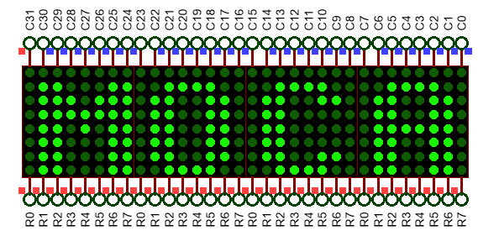
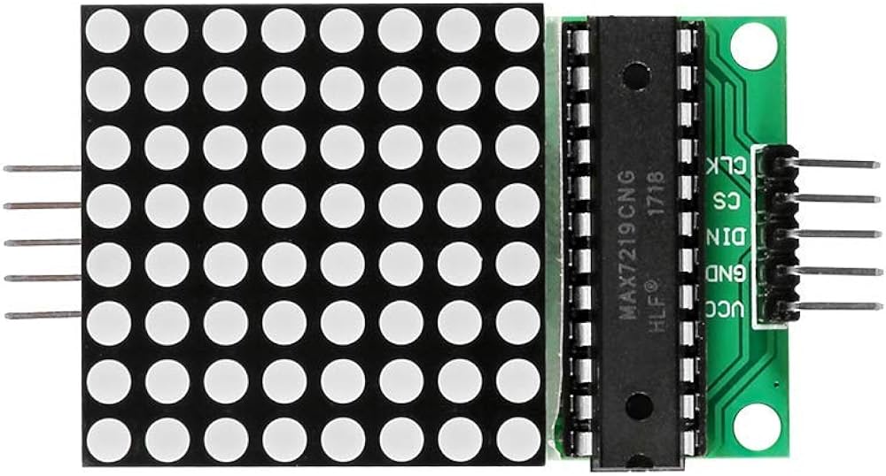
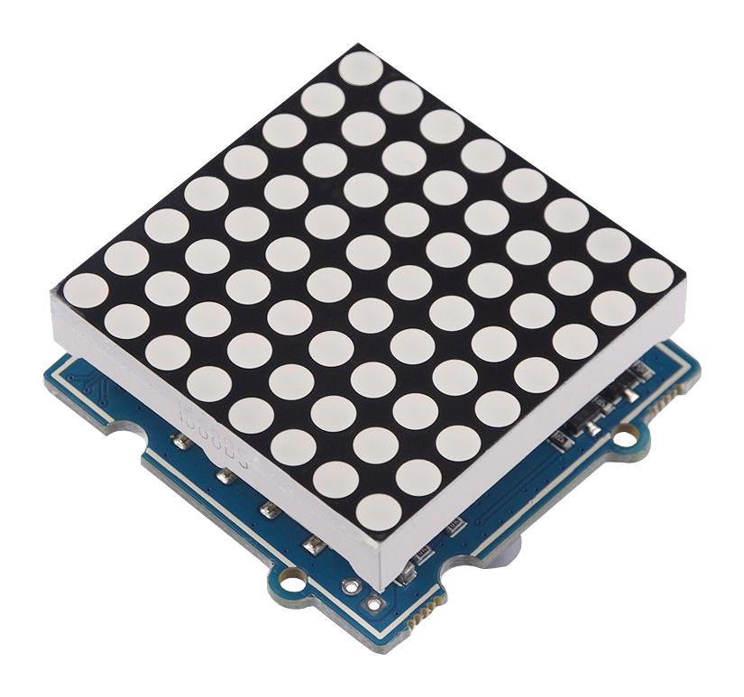
STM32 – ARM CORTEX M
LAB 3:
GPIO – LED
MATRIX
STM32 EMBEDDED PROGRAMING
DO TRUNG HAU

Slide 2

CONTENTS
1. SCAN A LED MATRIX 8X8 IN PARALLEL
2. SCAN A LED MATRIX IN SERIAL
3. SCAN 4 LED MATRIX IN SERIAL
STM32 EMBEDDED SYSTEMS
ARM CORTEX M

Slide 3
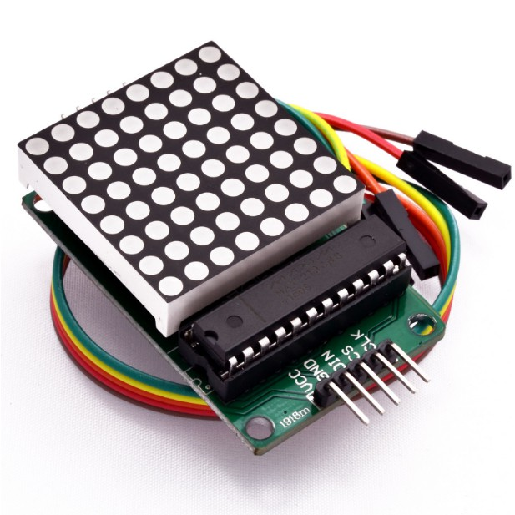
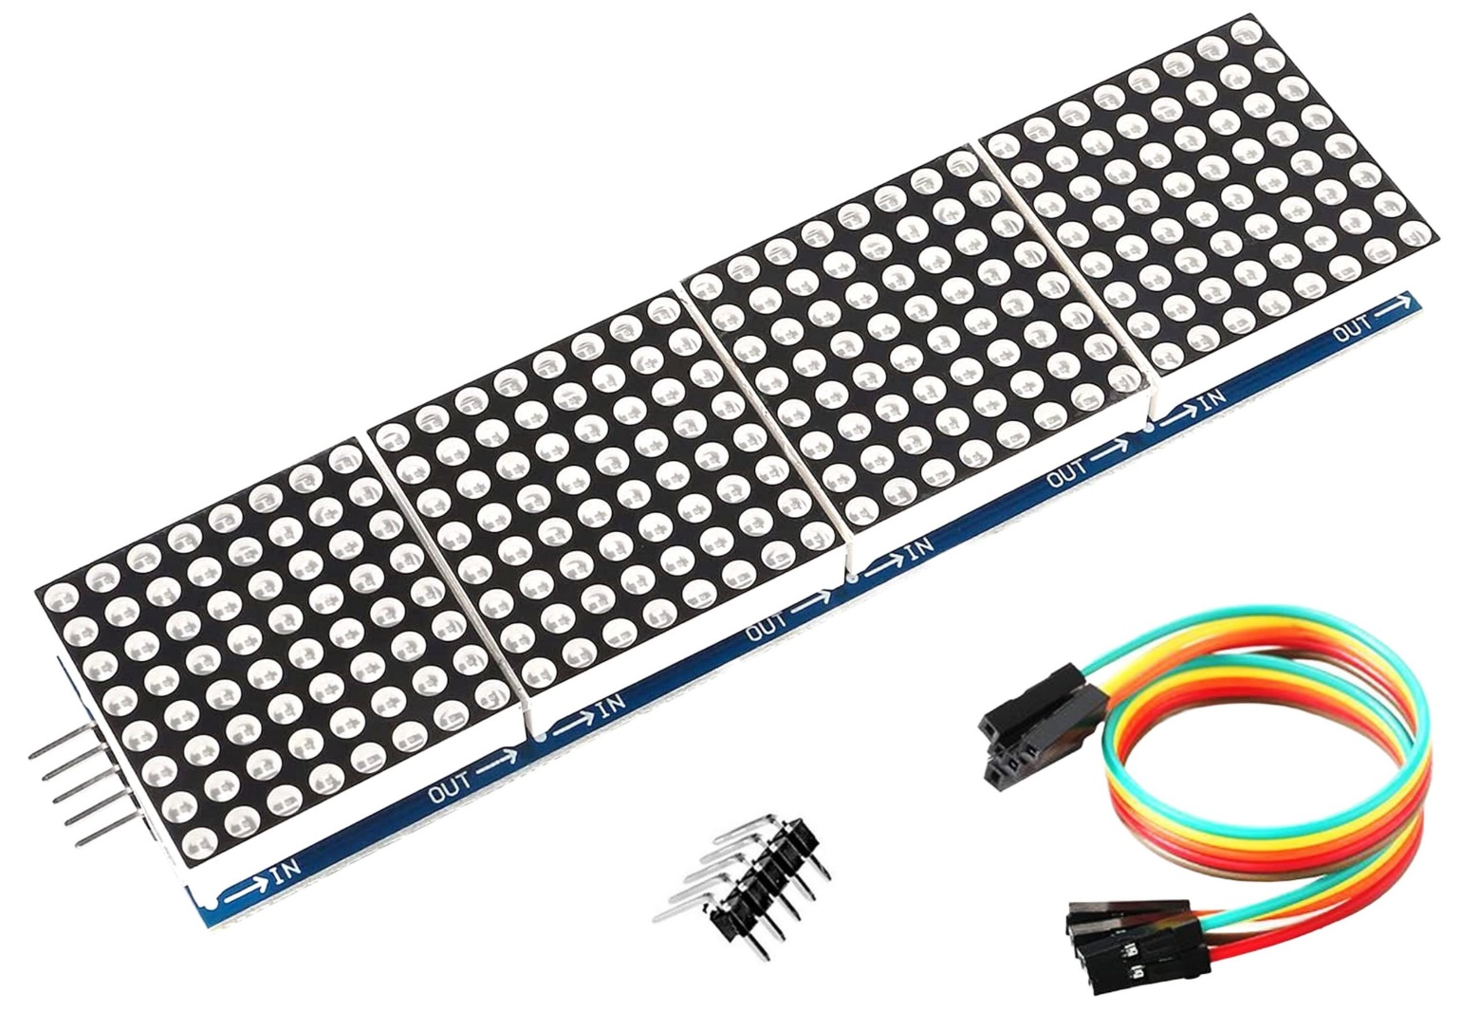
LAB 3: GPIO – LED MATRIX
1. SCAN A LED MATRIX IN PARALLEL
LED MATRIX AND DRIVER
STM32 EMBEDDED SYSTEMS
ARM CORTEX M

Slide 4
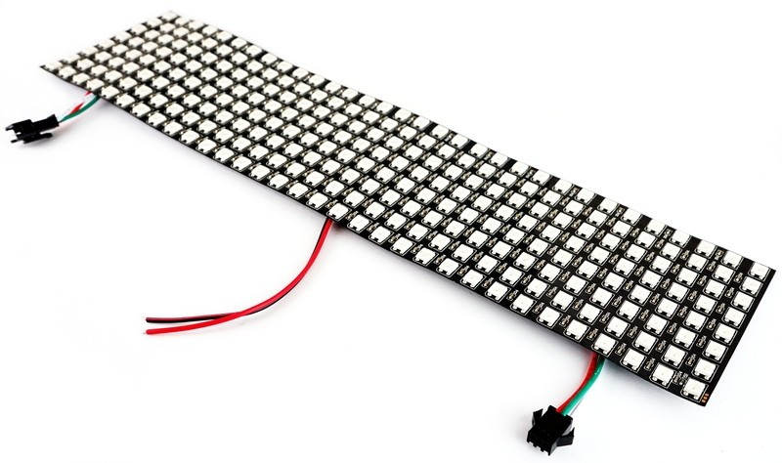
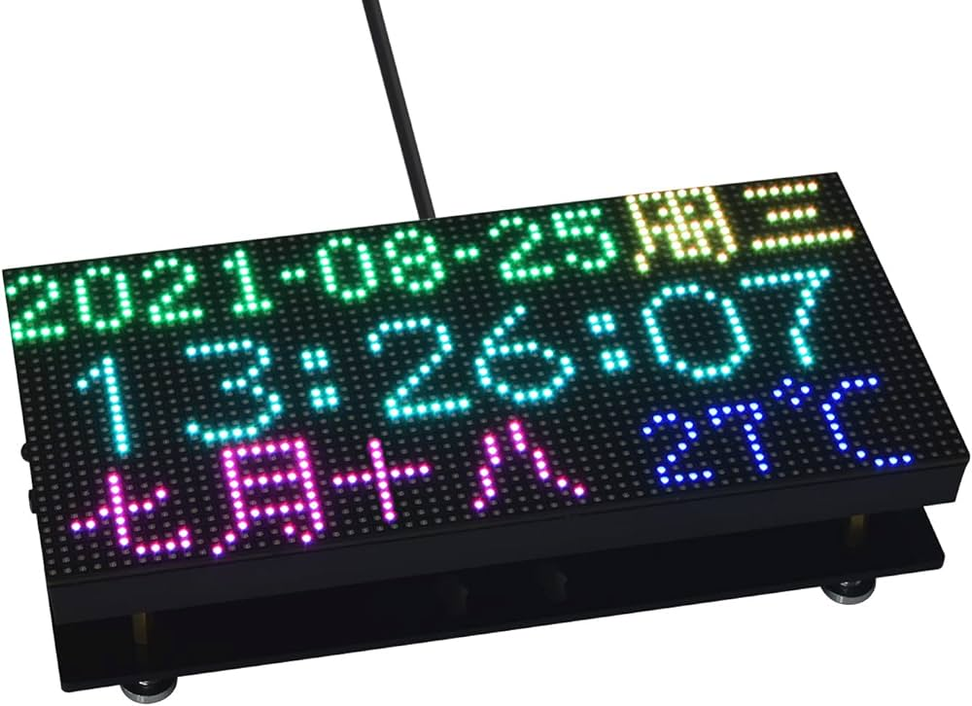
LAB 3: GPIO – LED MATRIX
1. SCAN A LED MATRIX IN PARALLEL
LED MATRIX AND DRIVER
STM32 EMBEDDED SYSTEMS
ARM CORTEX M

Slide 5
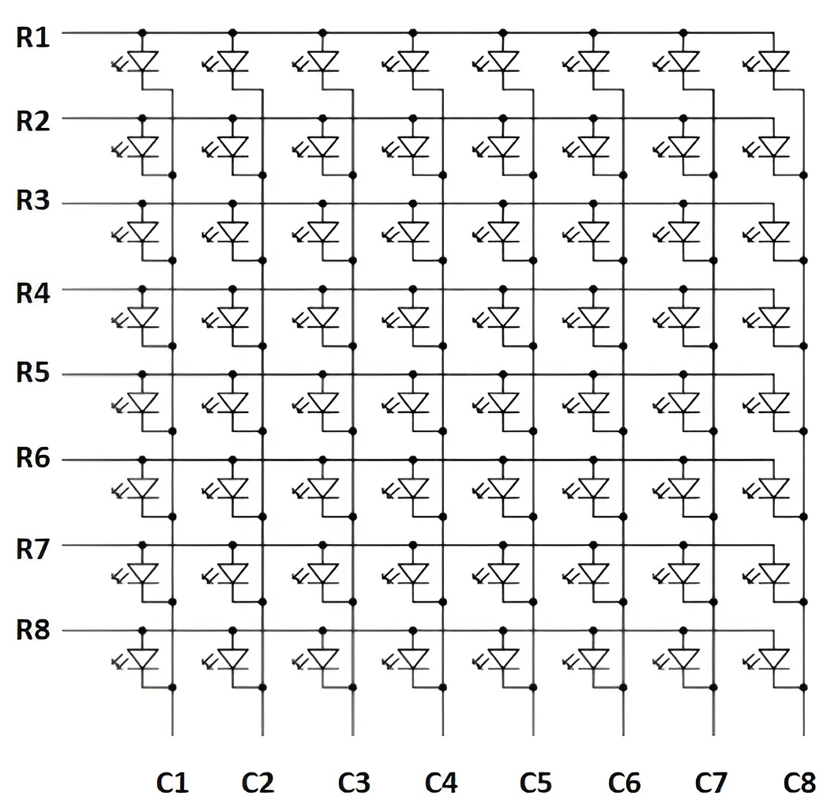
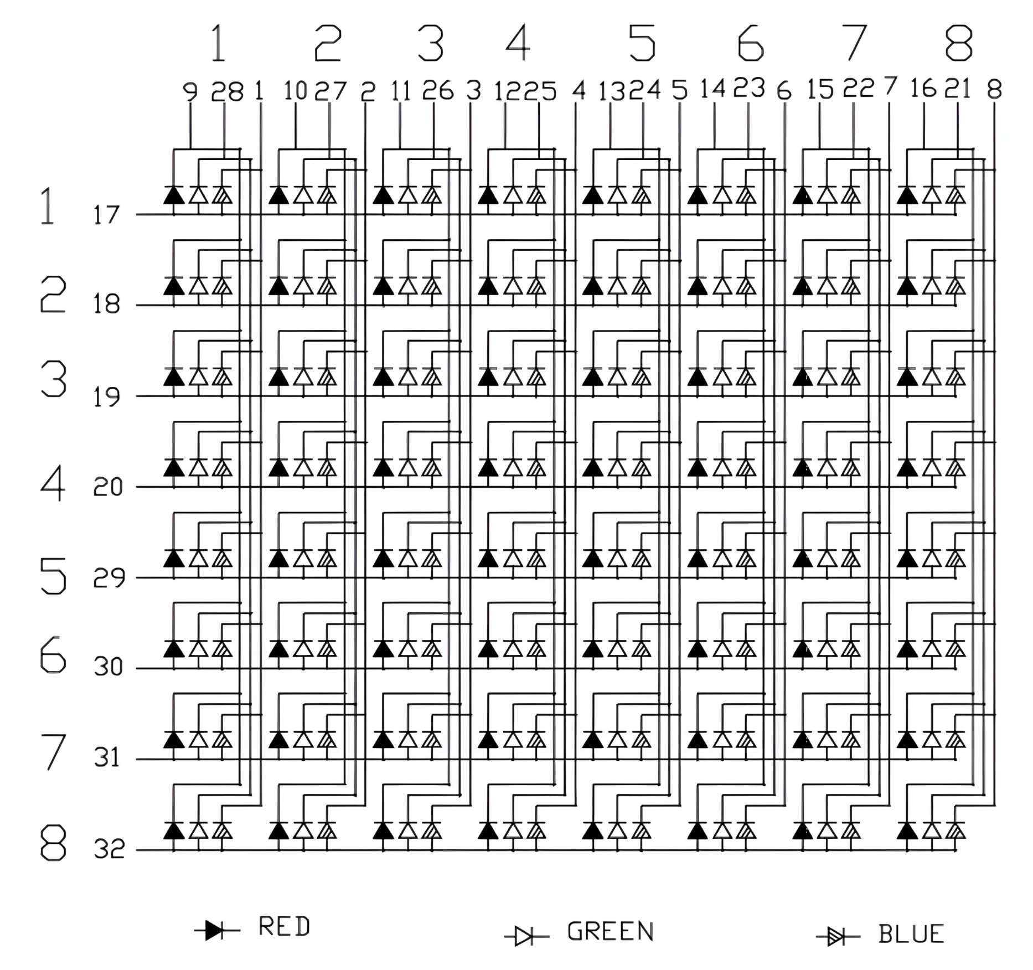
LAB 3: GPIO – LED MATRIX
1. SCAN A LED MATRIX IN PARALLEL
LED MATRIX AND DRIVER
STM32 EMBEDDED SYSTEMS
ARM CORTEX M

Slide 6
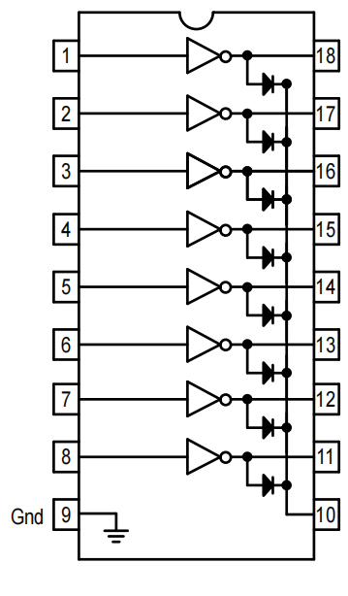
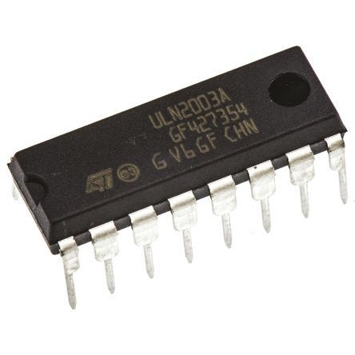
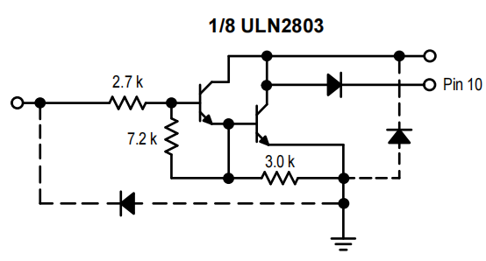
LAB 3: GPIO – LED MATRIX
1. SCAN A LED MATRIX IN PARALLEL
DRIVER ULN2803
STM32 EMBEDDED SYSTEMS
ARM CORTEX M

Slide 7
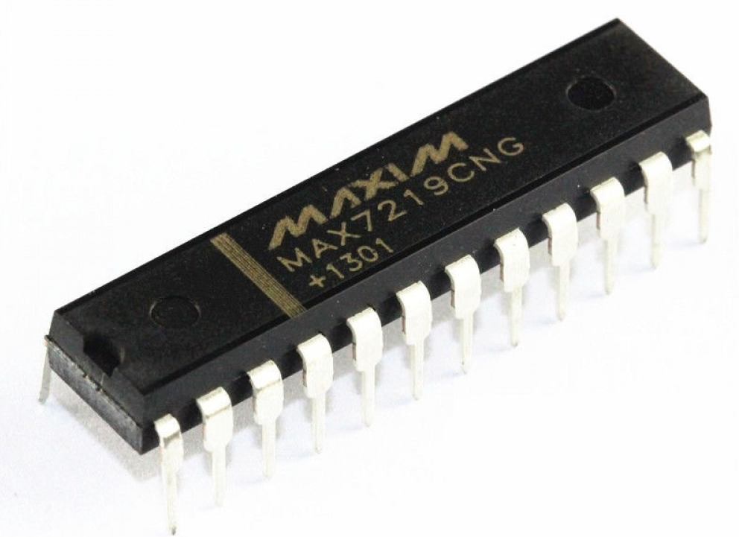
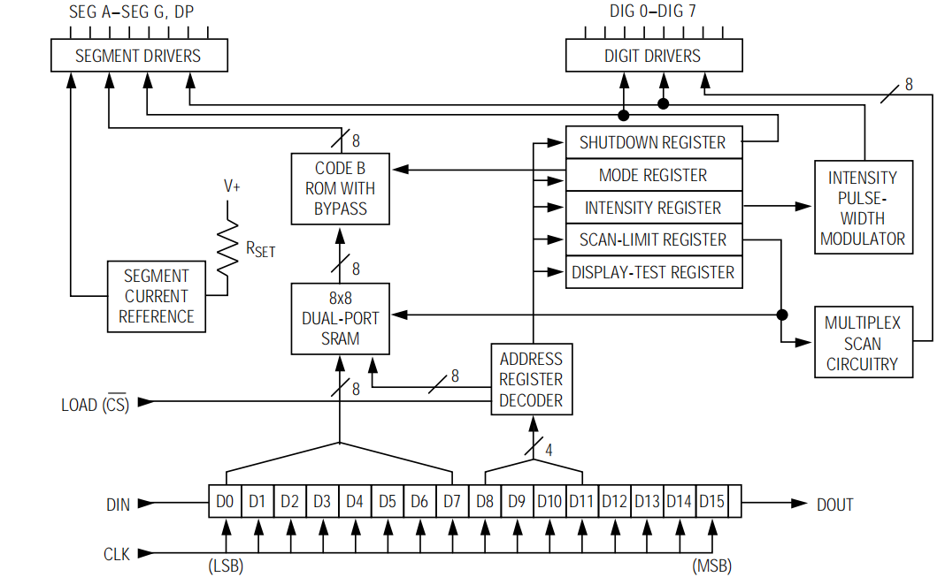
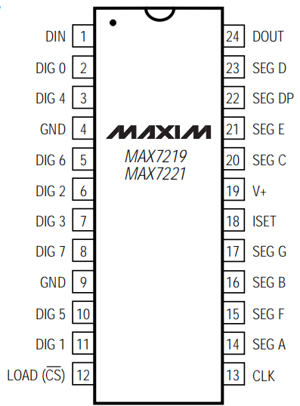
LAB 3: GPIO – LED MATRIX
1. SCAN A LED MATRIX IN PARALLEL
DRIVER MAX7219
STM32 EMBEDDED SYSTEMS
ARM CORTEX M

Slide 8
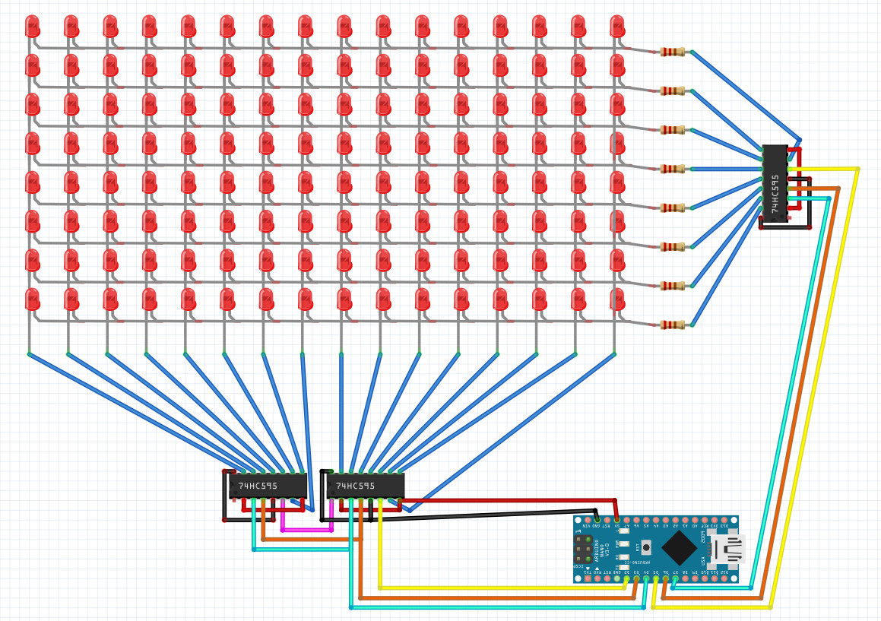
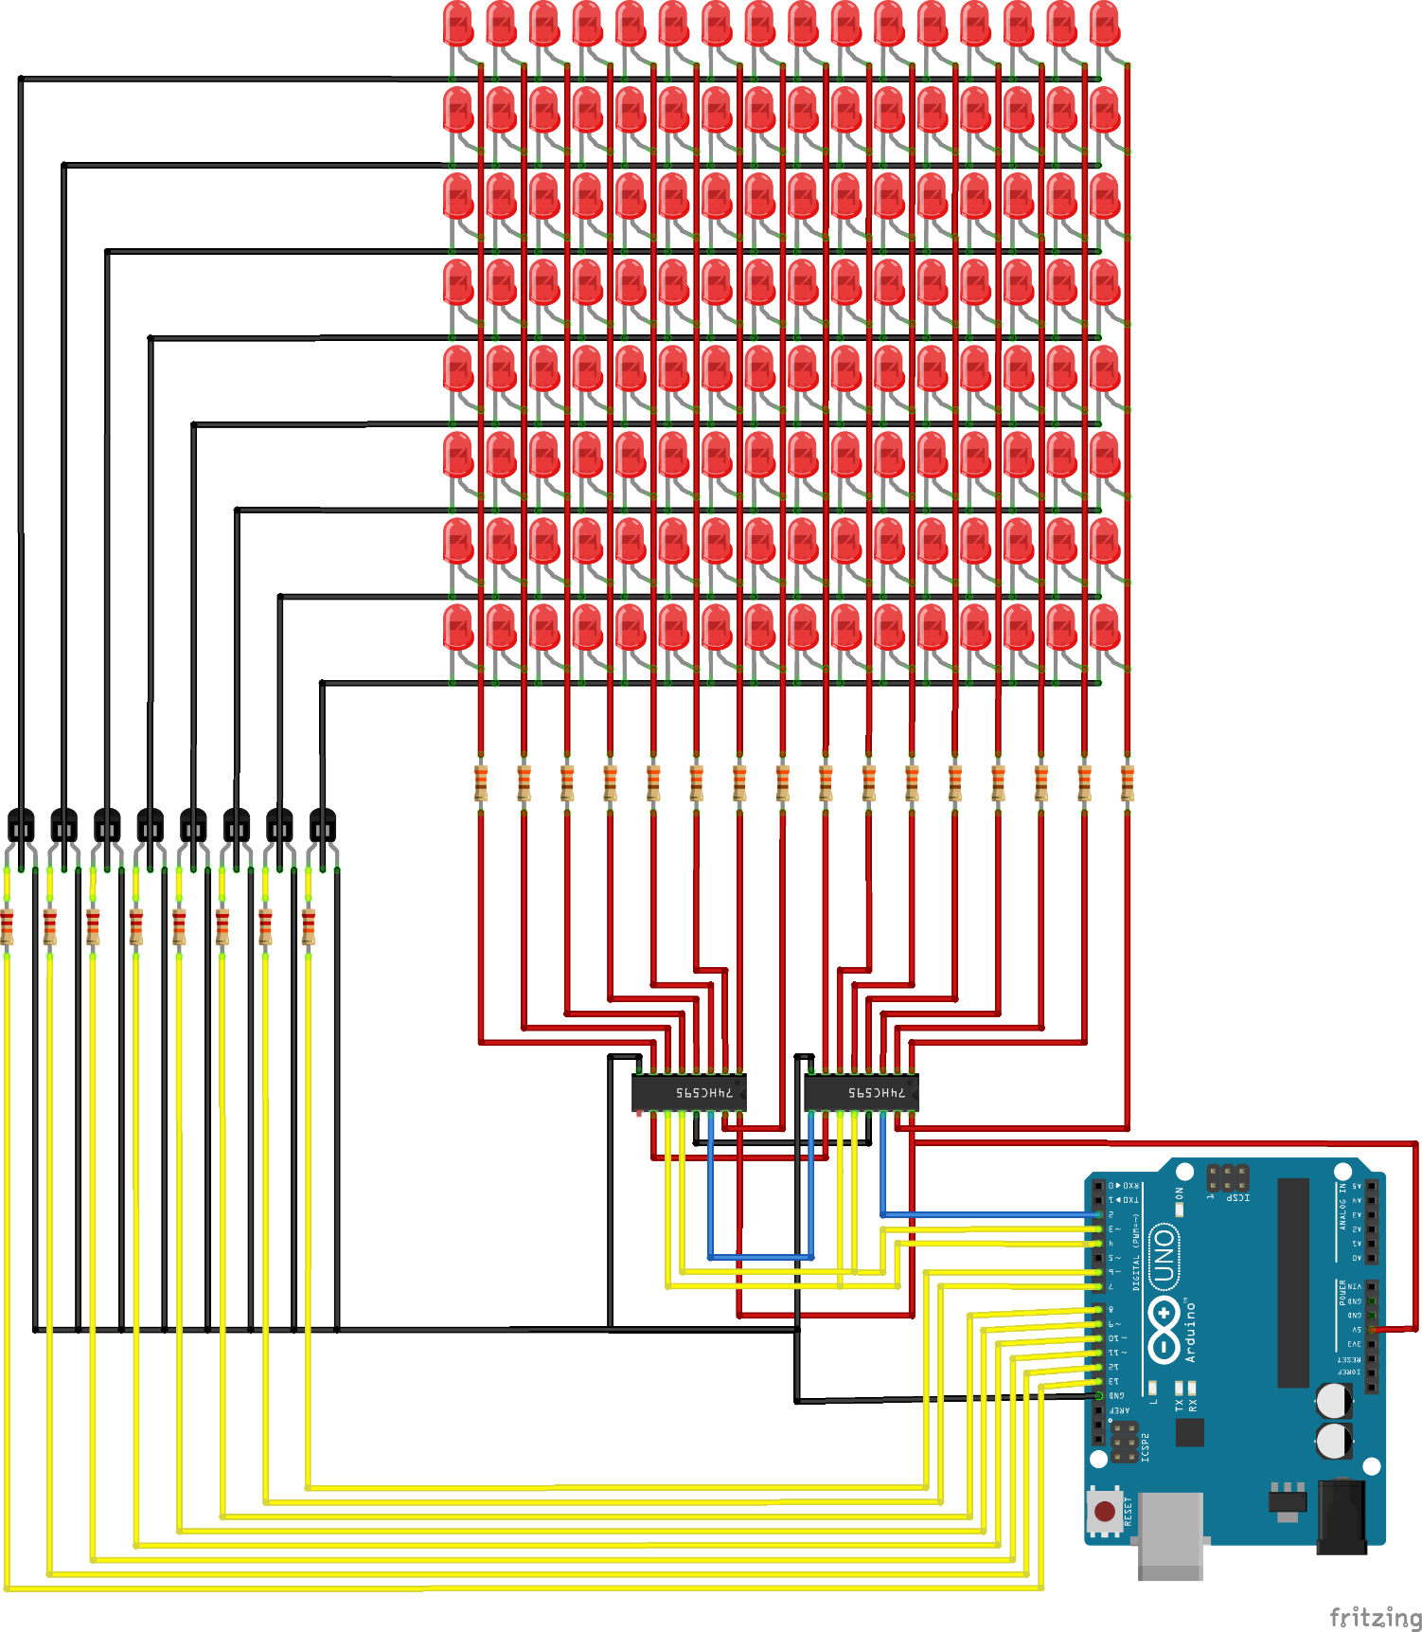
LAB 3: GPIO – LED MATRIX
1. SCAN A LED MATRIX IN PARALLEL
LED MATRIX AND DRIVER
STM32 EMBEDDED SYSTEMS
ARM CORTEX M

Slide 9
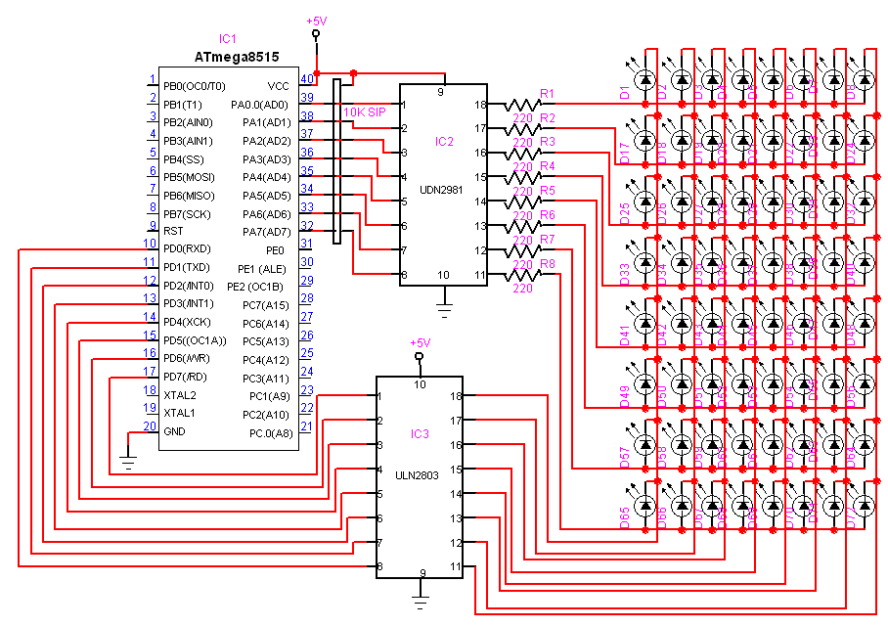
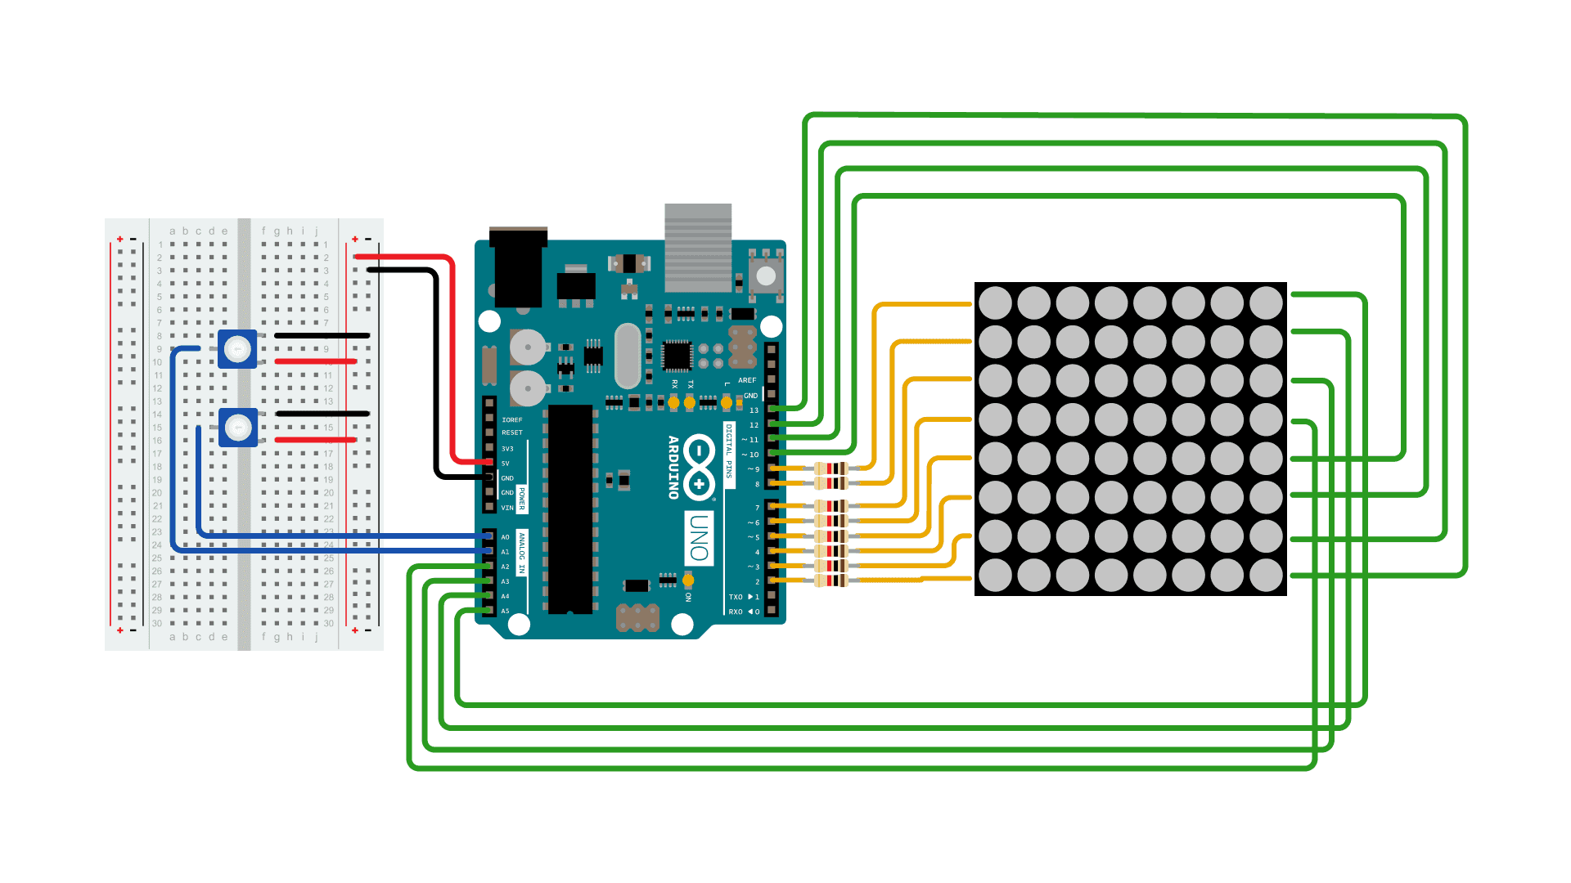
LAB 3: GPIO – LED MATRIX
1. SCAN A LED MATRIX IN PARALLEL
LED MATRIX AND DRIVER
STM32 EMBEDDED SYSTEMS
ARM CORTEX M

Slide 10
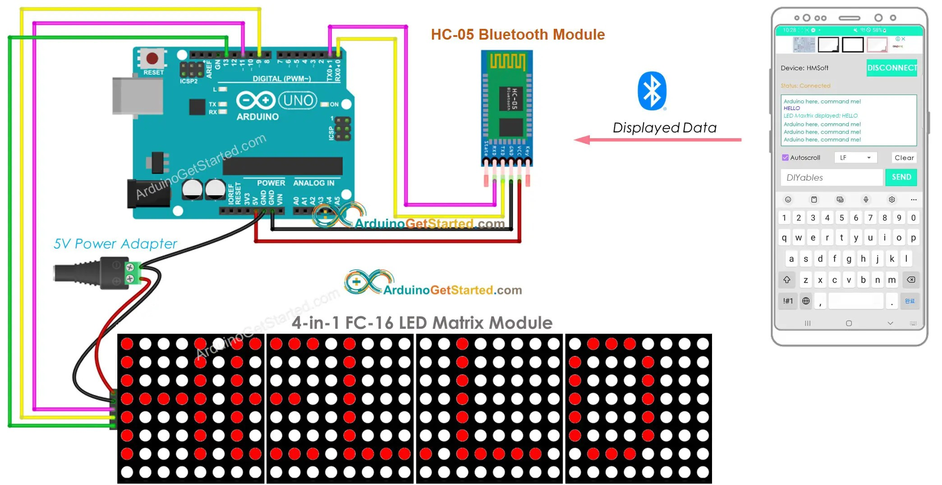
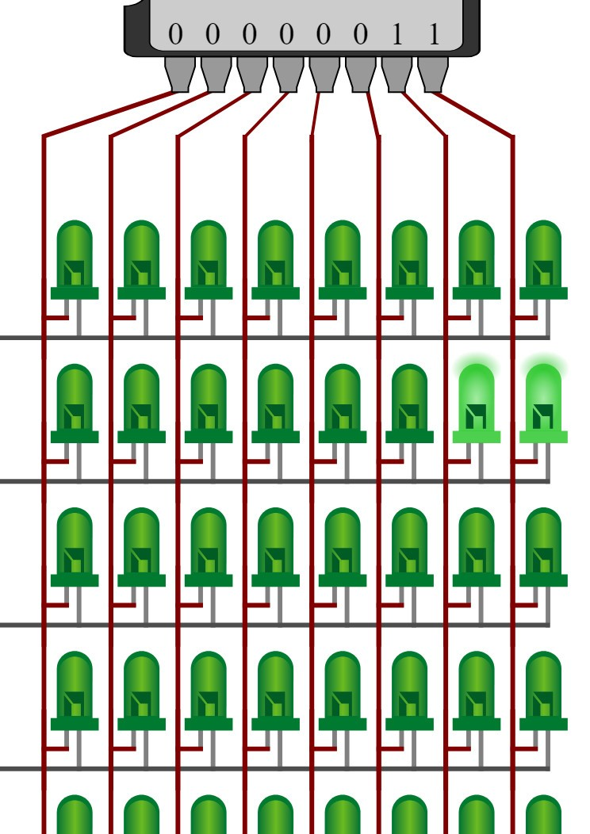
LAB 3: GPIO – LED MATRIX
1. SCAN A LED MATRIX IN PARALLEL
LED MATRIX AND DRIVER
STM32 EMBEDDED SYSTEMS
ARM CORTEX M

Slide 11
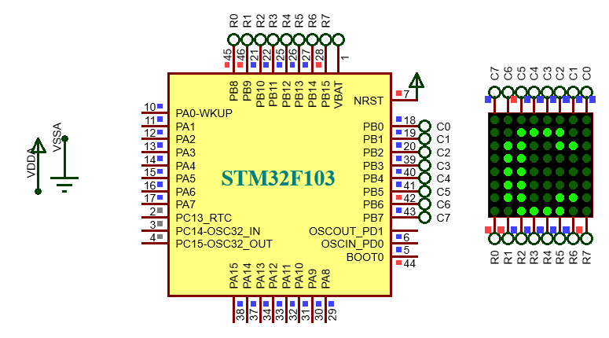
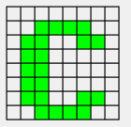
LAB 3: GPIO – LED MATRIX
1. SCAN A LED MATRIX IN PARALLEL
P1. Write a program to control a led matrix 8x8 to display alphabet letters and numbers 0 – 9.
STM32 EMBEDDED SYSTEMS
ARM CORTEX M

Slide 12
LAB 3: GPIO – LED MATRIX
P1. Write a program to control a led matrix 8x8 to display alphabet letters and numbers 0 – 9.
void output_h(uint8_t byte)
{
HAL_GPIO_WritePin(GPIOB,GPIO_PIN_15,(GPIO_PinState)(byte&128));
HAL_GPIO_WritePin(GPIOB,GPIO_PIN_14,(GPIO_PinState)(byte&64));
HAL_GPIO_WritePin(GPIOB,GPIO_PIN_13,(GPIO_PinState)(byte&32));
HAL_GPIO_WritePin(GPIOB,GPIO_PIN_12,(GPIO_PinState)(byte&16)); HAL_GPIO_WritePin(GPIOB,GPIO_PIN_11,(GPIO_PinState)(byte&8)); HAL_GPIO_WritePin(GPIOB,GPIO_PIN_10,(GPIO_PinState)(byte&4)); HAL_GPIO_WritePin(GPIOB,GPIO_PIN_9,(GPIO_PinState)(byte&2)); HAL_GPIO_WritePin(GPIOB,GPIO_PIN_8,(GPIO_PinState)(byte&1));
}
STM32 EMBEDDED SYSTEMS
ARM CORTEX M

Slide 13
LAB 3: GPIO – LED MATRIX
P1. Write a program to control a led matrix 8x8 to display alphabet letters and numbers 0 – 9.
void output_c(uint8_t byte)
{
HAL_GPIO_WritePin(GPIOB,GPIO_PIN_7,(GPIO_PinState)(byte&128));
HAL_GPIO_WritePin(GPIOB,GPIO_PIN_6,(GPIO_PinState)(byte&64)); HAL_GPIO_WritePin(GPIOB,GPIO_PIN_5,(GPIO_PinState)(byte&32)); HAL_GPIO_WritePin(GPIOB,GPIO_PIN_4,(GPIO_PinState)(byte&16)); HAL_GPIO_WritePin(GPIOB,GPIO_PIN_3,(GPIO_PinState)(byte&8)); HAL_GPIO_WritePin(GPIOB,GPIO_PIN_2,(GPIO_PinState)(byte&4)); HAL_GPIO_WritePin(GPIOB,GPIO_PIN_1,(GPIO_PinState)(byte&2)); HAL_GPIO_WritePin(GPIOB,GPIO_PIN_0,(GPIO_PinState)(byte&1));
}
STM32 EMBEDDED SYSTEMS
ARM CORTEX M

Slide 14
LAB 3: GPIO – LED MATRIX
P1. Write a program to control a led matrix 8x8 to display alphabet letters and numbers 0 – 9.
void matrix_display(uint8_t in)
{
uint8_t dich = 0;
for(uint8_t i=0; i<8; i++)
{
dich = 0x80>>i;
output_c(dich);
output_h(character[in][i]);
HAL_Delay(1);
output_c(0);
}
}
uint8_t character[][8] = {
{0xFF,0x03,0x01,0xED,0xED,0x01,0x03,0xFF}, {0xFF,0x01,0x01,0x6D,0x6D,0x01,0x93,0xFF},//B {0xFF,0x83,0x01,0x7D,0x7D,0x39,0xBB,0xFF},//C {0xFF,0x01,0x01,0x7D,0x7D,0x01,0x83,0xFF},//D {0xFF,0x01,0x01,0x6D,0x6D,0x6D,0x7D,0xFF},//E {0xFF,0x01,0x01,0xED,0xED,0xED,0xFD,0xFF},//F {0xFF,0x83,0x01,0x7D,0x5D,0x19,0x9B,0xFF},//G {0xFF,0x01,0x01,0xEF,0xEF,0x01,0x01,0xFF},//H {0xFF,0xFF,0x7D,0x01,0x01,0x7D,0xFF,0xFF},//I {0xFF,0x9F,0x9F,0x7D,0x01,0x81,0xFD,0xFF},//J {0xFF,0x01,0x01,0xC7,0x93,0x39,0x7D,0xFF},//K {0xFF,0x01,0x01,0x7F,0x7F,0x7F,0x7F,0xFF},//L {0xFF,0x01,0x01,0xF3,0xE7,0xF3,0x01,0x01},//M
matrix_display(2);
STM32 EMBEDDED SYSTEMS
ARM CORTEX M

Slide 15
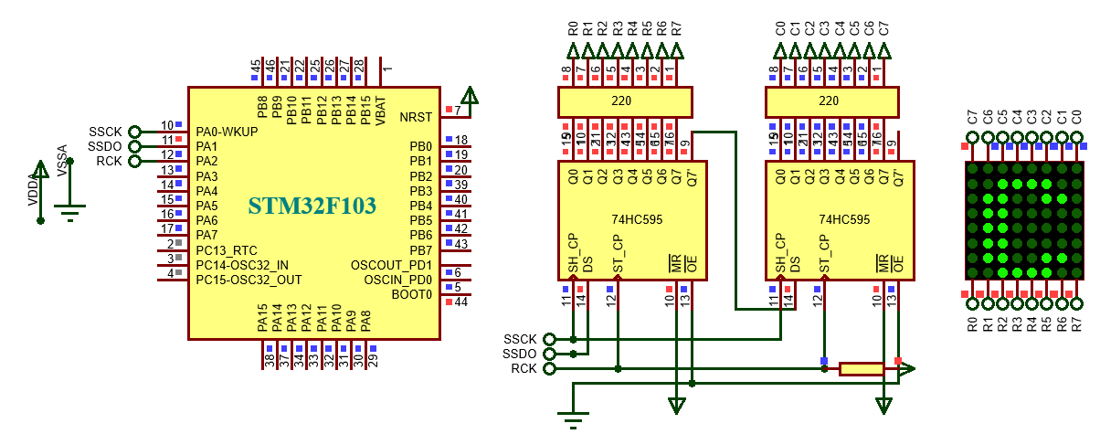
LAB 3: GPIO – LED MATRIX
2. SCAN A LED MATRIX IN SERIAL
P2. Write a program to control a led matrix 8x8 to display alphabet letters and numbers 0 – 9. Using IC 74HC595 for scan data and display data.
STM32 EMBEDDED SYSTEMS
ARM CORTEX M

Slide 16
LAB 3: GPIO – LED MATRIX
P2. Write a program to control a led matrix 8x8 to display alphabet letters and numbers 0 – 9. Using IC 74HC595 for scan data and display data.
void put1_byte(uint8_t byte)
{
for(uint8_t i = 0; i < 8; i++)
{
HAL_GPIO_WritePin(GPIOA,GPIO_PIN_1,(GPIO_PinState)(byte&(0x80 >> i)));
HAL_GPIO_WritePin(GPIOA,GPIO_PIN_0, GPIO_PIN_SET ); HAL_GPIO_WritePin(GPIOA,GPIO_PIN_0, GPIO_PIN_RESET );
}
}
STM32 EMBEDDED SYSTEMS
ARM CORTEX M

Slide 17
LAB 3: GPIO – LED MATRIX
P2. Write a program to control a led matrix 8x8 to display alphabet letters and numbers 0 – 9. Using IC 74HC595 for scan data and display data.
void matrix_display(uint8_t in)
{
for(uint8_t i=0; i<8; i++)
{
dich = 0x80>>i;
put1_byte(dich); put1_byte(character[in][i]);
HAL_GPIO_WritePin(GPIOA, GPIO_PIN_2, GPIO_PIN_SET);
HAL_GPIO_WritePin(GPIOA, GPIO_PIN_2, GPIO_PIN_RESET);
HAL_Delay(1);
put1_byte(0); put1_byte(0xff);
HAL_GPIO_WritePin(GPIOA, GPIO_PIN_2, GPIO_PIN_SET);
HAL_GPIO_WritePin(GPIOA, GPIO_PIN_2, GPIO_PIN_RESET);
}
}
STM32 EMBEDDED SYSTEMS
ARM CORTEX M

Slide 18
LAB 3: GPIO – LED MATRIX
P3. Write a program to scroll datas on led matrix.
void matrix_display_scroll()
{
uint8_t dich = 0;
for(uint8_t i=0; i<8; i++)
{
dich = 0x80>>i;
put1_byte(dich); put1_byte(scroll_data[i]); HAL_GPIO_WritePin(GPIOA, GPIO_PIN_2, GPIO_PIN_SET); HAL_GPIO_WritePin(GPIOA, GPIO_PIN_2, GPIO_PIN_RESET); HAL_Delay(1);
put1_byte(0); put1_byte(0xff); HAL_GPIO_WritePin(GPIOA, GPIO_PIN_2, GPIO_PIN_SET); HAL_GPIO_WritePin(GPIOA, GPIO_PIN_2, GPIO_PIN_RESET);
}
}
STM32 EMBEDDED SYSTEMS
ARM CORTEX M

Slide 19
LAB 3: GPIO – LED MATRIX
P3. Write a program to scroll datas on led matrix.
uint8_t tempt;
uint8_t scroll_data[16] = { 0xFF, 0XFF, 0XFF, 0XFF, 0XFF, 0XFF, 0XFF, 0XFF, 0xFF,0x83,0x01,0x7D,0x7D,0x39,0xBB,0xFF };
tempt = scroll_data[0];
for(uint8_t i = 0; i < 15; i++)
scroll_data[i] = scroll_data[i+1];
scroll_data[15] = tempt;
for(uint8_t p = 0; p < 10; p++) matrix_display_scroll();
STM32 EMBEDDED SYSTEMS
ARM CORTEX M

Slide 20
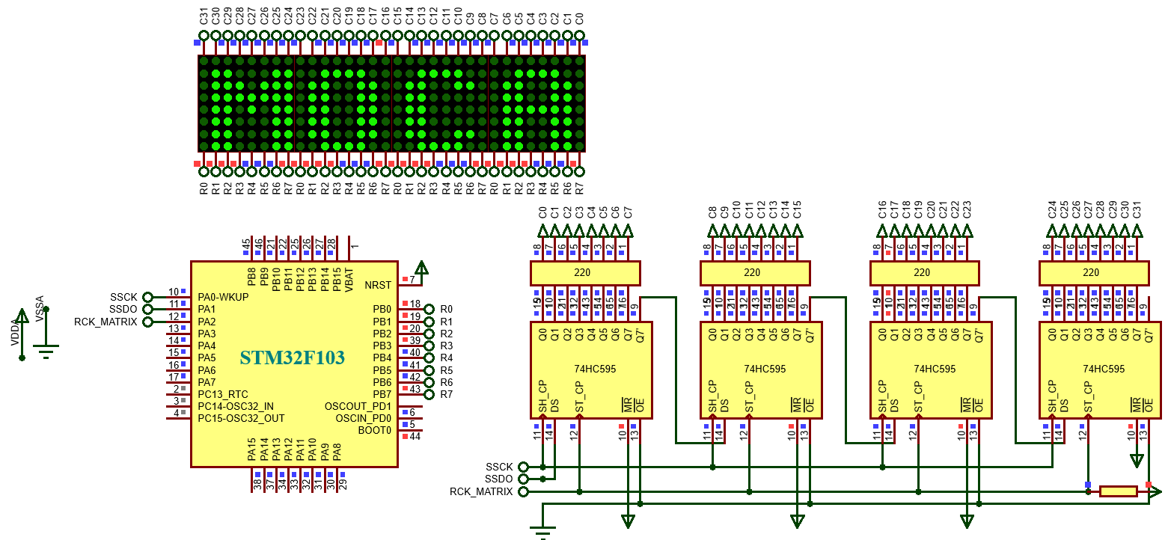
LAB 3: GPIO – LED MATRIX
3. SCAN 4 LED MATRIX IN SERIAL
P4. Write a program to control 4 leds matrix 8x8 to display alphabet letters and numbers 0 – 9. Using 4 IC 74HC595 for scan data and 8 GPIO pins B0 – B7 to put display data. Then display 4 letters “MOCA”.
STM32 EMBEDDED SYSTEMS
ARM CORTEX M

Slide 21
LAB 3: GPIO – LED MATRIX
P4. Write a program to control 4 leds matrix 8x8 to display alphabet letters and numbers 0 – 9. Using 4 IC 74HC595 for scan data and 8 GPIO pins B0 – B7 to put display data. Then display 4 letters “MOCA”.
void output_b(uint8_t byte)
{
HAL_GPIO_WritePin(GPIOB,GPIO_PIN_7,(GPIO_PinState)(byte&128));
HAL_GPIO_WritePin(GPIOB,GPIO_PIN_6,(GPIO_PinState)(byte&64));
HAL_GPIO_WritePin(GPIOB,GPIO_PIN_5,(GPIO_PinState)(byte&32));
HAL_GPIO_WritePin(GPIOB,GPIO_PIN_4,(GPIO_PinState)(byte&16));
HAL_GPIO_WritePin(GPIOB,GPIO_PIN_3,(GPIO_PinState)(byte&8));
HAL_GPIO_WritePin(GPIOB,GPIO_PIN_2,(GPIO_PinState)(byte&4));
HAL_GPIO_WritePin(GPIOB,GPIO_PIN_1,(GPIO_PinState)(byte&2));
HAL_GPIO_WritePin(GPIOB,GPIO_PIN_0,(GPIO_PinState)(byte&1));
}
STM32 EMBEDDED SYSTEMS
ARM CORTEX M

Slide 22
LAB 3: GPIO – LED MATRIX
void matrix_display() {
uint8_t dich = 0;
for(uint8_t i=0; i<32; i++)
{
dich = 0x80000000>>i;
put1_byte(dich>>24); put1_byte(dich>>16); put1_byte(dich>>8); put1_byte(dich);
HAL_GPIO_WritePin(GPIOA, GPIO_PIN_2, GPIO_PIN_SET); HAL_GPIO_WritePin(GPIOA, GPIO_PIN_2, GPIO_PIN_RESET); output_b(characters[i]);
delay_us(995);
put1_byte(0); put1_byte(0); put1_byte(0); put1_byte(0); HAL_GPIO_WritePin(GPIOA, GPIO_PIN_2, GPIO_PIN_SET); HAL_GPIO_WritePin(GPIOA, GPIO_PIN_2, GPIO_PIN_RESET); output_b(0xff);
}
}
STM32 EMBEDDED SYSTEMS
ARM CORTEX M

Slide 23
LAB 3: GPIO – LED MATRIX
P4. Write a program to control 4 leds matrix 8x8 to display alphabet letters and numbers 0 – 9. Using 4 IC 74HC595 for scan data and 8 GPIO pins B0 – B7 to put display data. Then display 4 letters “MOCA”.
void delay_us(uint32_t us)
{ for (uint32_t i = 0; i < us; ++i); }
uint8_t data_led[32] = {
0xFF,0x01,0x01,0xF3,0xE7,0xF3,0x01,0x01, 0xFF,0x83,0x01,0x7D,0x7D,0x01,0x83,0xFF, 0xFF,0x83,0x01,0x7D,0x7D,0x39,0xBB,0xFF, 0xFF,0x03,0x01,0xED,0xED,0x01,0x03,0xFF };
matrix_display();
STM32 EMBEDDED SYSTEMS
ARM CORTEX M

Slide 24
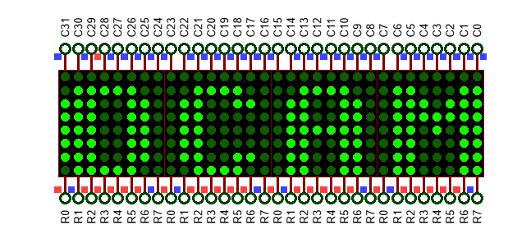
LAB 3: GPIO – LED MATRIX
P5. Write a program to scroll the display of P4.
tam = data_led[0];
for(uint8_t n = 0; n < 47; n++)
data_led[n] = data_led[n + 1];
data_led[47] = tam;
//for(uint8_t h = 0; h < 10; h++)
matrix_display();
STM32 EMBEDDED SYSTEMS
ARM CORTEX M

Slide 25
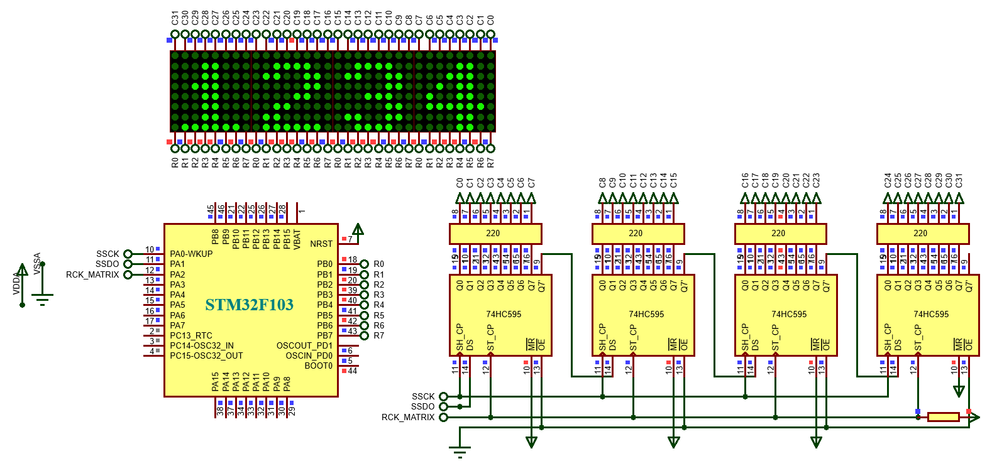
LAB 3: GPIO – LED MATRIX
P6. Write a program to display 4 number “1234”, the display data is independane for each led.
STM32 EMBEDDED SYSTEMS
ARM CORTEX M

Slide 26
LAB 3: GPIO – LED MATRIX
P6. Write a program to display 4 number “1234”, the display data is independane for each led.
uint8_t led_matrix1[8] = {0xFF,0x7F,0x77,0x01,0x01,0x7F,0x7F,0xFF};
uint8_t led_matrix2[8] = {0xFF,0x3B,0x19,0x5D,0x6D,0x61,0x73,0xFF};
uint8_t led_matrix3[8] = {0xFF,0xBB,0x39,0x6D,0x6D,0x01,0x93,0xFF};
uint8_t led_matrix4[8] = {0xFF,0xCF,0xD7,0xDB,0x01,0x01,0xDF,0xFF};
STM32 EMBEDDED SYSTEMS
ARM CORTEX M

Slide 27
LAB 3: GPIO – LED MATRIX
P6. Write a program to display 4 number “1234”, the display data is independane for each led.
if(i<8) output_b(led_matrix1[i]);
else if(i<16) output_b(led_matrix2[i-8]);
else if(i<24) output_b(led_matrix3[i-16]);
else output_b(led_matrix4[i-24]);
STM32 EMBEDDED SYSTEMS
ARM CORTEX M

Slide 28
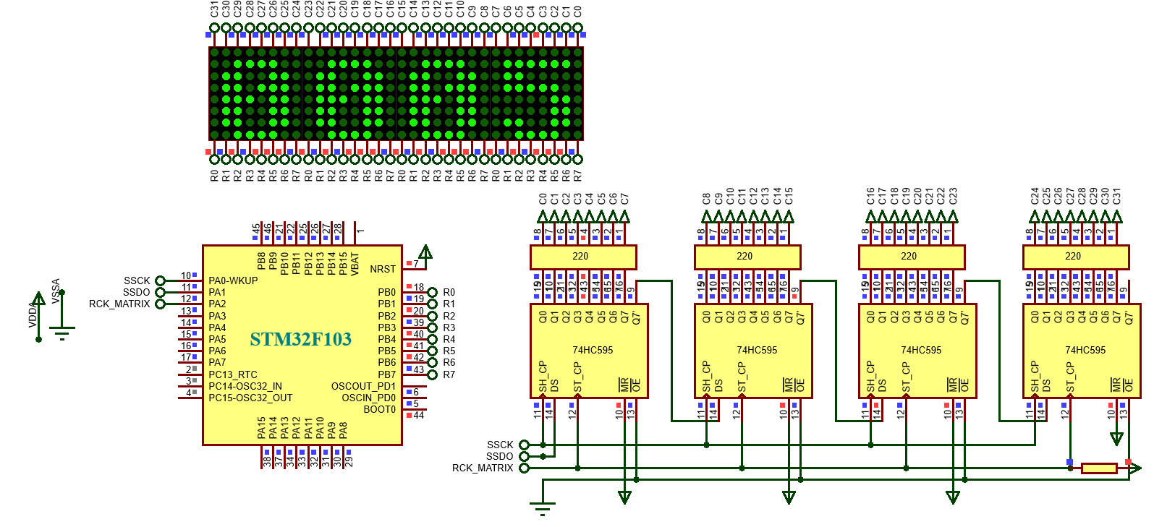
LAB 3: GPIO – LED MATRIX
P6. Write a program display the numbers 0000 – 9999.
STM32 EMBEDDED SYSTEMS
ARM CORTEX M

Slide 29
LAB 3: GPIO – LED MATRIX
P6. Write a program display the numbers 0000 – 9999.
uint8_t num[10][8] = { {0xFF,0x83,0x01,0x6D,0x75,0x01,0x83,0xFF},//0 {0xFF,0x7F,0x77,0x01,0x01,0x7F,0x7F,0xFF},//1 {0xFF,0x3B,0x19,0x5D,0x6D,0x61,0x73,0xFF},//2 {0xFF,0xBB,0x39,0x6D,0x6D,0x01,0x93,0xFF},//3 {0xFF,0xCF,0xD7,0xDB,0x01,0x01,0xDF,0xFF},//4 {0xFF,0xB1,0x31,0x75,0x75,0x05,0x8D,0xFF},//5 {0xFF,0x83,0x01,0x6D,0x6D,0x09,0x9B,0xFF},//6 {0xFF,0xF9,0xF9,0x1D,0x05,0xE1,0xF9,0xFF},//7 {0xFF,0x93,0x01,0x6D,0x6D,0x01,0x93,0xFF},//8 {0xFF,0xB3,0x21,0x6D,0x6D,0x01,0x83,0xFF},//9
};
STM32 EMBEDDED SYSTEMS
ARM CORTEX M

Slide 30
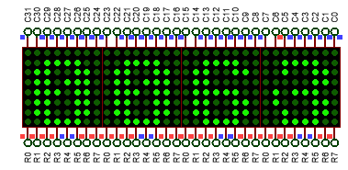
LAB 3: GPIO – LED MATRIX
P6. Write a program display the numbers 0000 – 9999.
for(uint8_t p = 0; p < 8; p++)
led_matrix1[p] = num[count/1000][p];
for(uint8_t p = 0; p < 8; p++)
led_matrix2[p] = num[count/100%10][p];
for(uint8_t p = 0; p < 8; p++)
led_matrix3[p] = num[count/10%10][p];
for(uint8_t p = 0; p < 8; p++) led_matrix4[p] = num[count%10][p];
//for(uint8_t p = 0; p < 10; p++)
matrix_display();
count++; count %= 10000;
STM32 EMBEDDED SYSTEMS
ARM CORTEX M

Slide 31
LAB 3: GPIO – LED MATRIX
P6. Write a program display the numbers 0000 – 9999 and scroll.
output_b(scroll_data[i]);
for(uint8_t p = 0; p < 8; p++)
led_matrix1[p] = num[count/1000][p];
for(uint8_t p = 0; p < 8; p++)
led_matrix2[p] = num[count/100%10][p]; for(uint8_t p = 0; p < 8; p++)
led_matrix3[p] = num[count/10%10][p];
for(uint8_t p = 0; p < 8; p++)
led_matrix4[p] = num[count%10][p];
STM32 EMBEDDED SYSTEMS
ARM CORTEX M

Slide 32
LAB 3: GPIO – LED MATRIX
P6. Write a program display the numbers 0000 – 9999 and scroll.
for(uint8_t p = 0; p < 48; p++)
{
if(p < 8) scroll_data[p] = 0xff;
else if(p < 16) scroll_data[p] = 0xff;
else if(p < 24) scroll_data[p] = led_matrix1[p - 16];
else if(p < 32) scroll_data[p] = led_matrix2[p - 24]; else if(p < 40) scroll_data[p] = led_matrix3[p - 32]; else scroll_data[p] = led_matrix4[p - 40];
}
STM32 EMBEDDED SYSTEMS
ARM CORTEX M

Slide 33
LAB 3: GPIO – LED MATRIX
P6. Write a program display the numbers 0000 – 9999 and scroll.
for(uint8_t i=0; i<48; i++)
{
temp = scroll_data[0];
for(uint8_t p = 0; p < 47; p++)
scroll_data[p] = scroll_data[p + 1]; scroll_data[47] = temp;
matrix_display();
}
count++; count %= 10000;
STM32 EMBEDDED SYSTEMS
ARM CORTEX M

